Slide 1


MIMO-2
CNSCC.405
Digital Signal Processing
Dr Muhammad Abrar (Dr. MAB)
m.abrar@lancaster.ac.uk

Slide 2

MIMO
As there are multiple antennas, MIMO systems can be employed for diversity gain.
MIMO can increase the data rate by transmitting several information streams in parallel
It is also known as spatial multiplexing as information is multiplexed over parallel streams in space
This is possible by using multidimensional signal processing

Slide 3
MIMO-Multiple Input Multiple Output
Receive antenna 1
Transmit antenna 1
Receive antenna 2
Transmit antenna 2
MIMO Channel
Transmit antenna t
Receive antenna r
= transmit vector
= receive vector

Slide 4
MIMO-Multiple Input Multiple Output
Flat fading channel coefficient
MIMO Channel Matrix

Slide 5
MIMO-Multiple Input Multiple Output
Interfere at receive antenna 1
Interfere at receive antenna 2
is the channel coefficient between the ith receive antenna and the jth transmit antenna
So total channel coefficients are

Slide 6
MIMO System Model
Dimensional noise vector
dimensional receive vector
Channel matrix
dimensional transmit vector

Slide 7
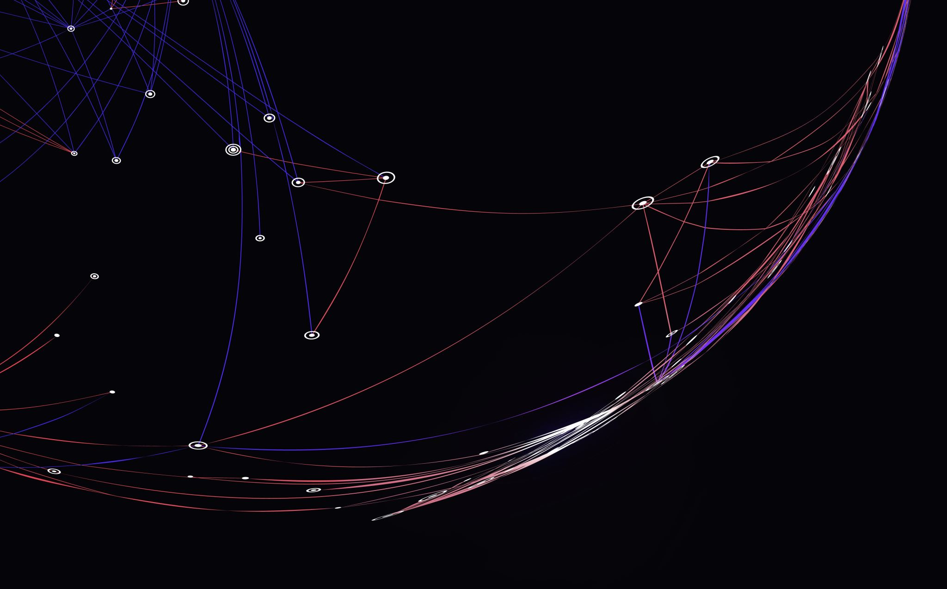
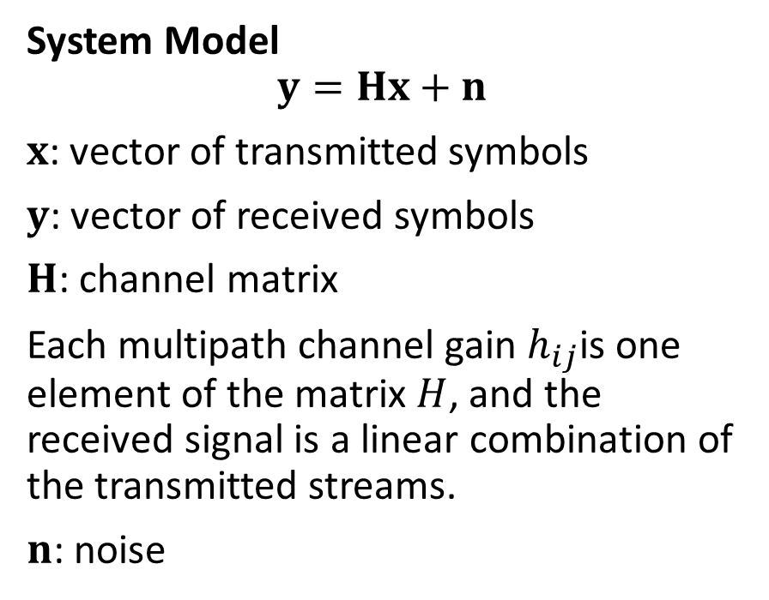
The MIMO system as a linear transformation
System Model
$$y=Hx+n$$
$x$: vector of transmitted symbols
$y$: vector of received symbols
$H$: channel matrix
Each multipath channel gain $h_{ij}$is one element of the matrix $H$, and the received signal is a linear combination of the transmitted streams.
$n$: noise

Slide 8
Types of MIMO
SIMO: receiver diversity
MISO: transmit diversity
MIMO: spatial multiplexing + diversity

Slide 9
MIMO Capacity on Fading channels
The capacity increase can be seen by comparing MIMO systems with SISO, SIMO, and MISO systems
SISO:capacity is given by Shannon’s classical formula:
Where B is the BW and h is the fading gain
SIMO (with M Receiving antennas), the capacity is given by
MISO (with M transmitting antennas), the capacity is given by

Slide 10
MIMO Capacity on Fading channels
The capacity for MIMO systems can have the following forms (Assuming Tx antennas = Rx antennas = N):
If the channel is known at the transmitter

Slide 11
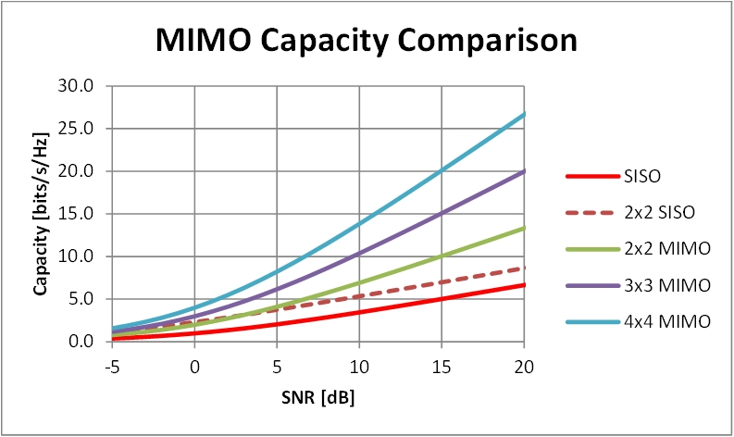
Average capacity of a MIMO Rayleigh fading channel

Slide 12
Spatial Multiplexing and Diversity Gain

Slide 13

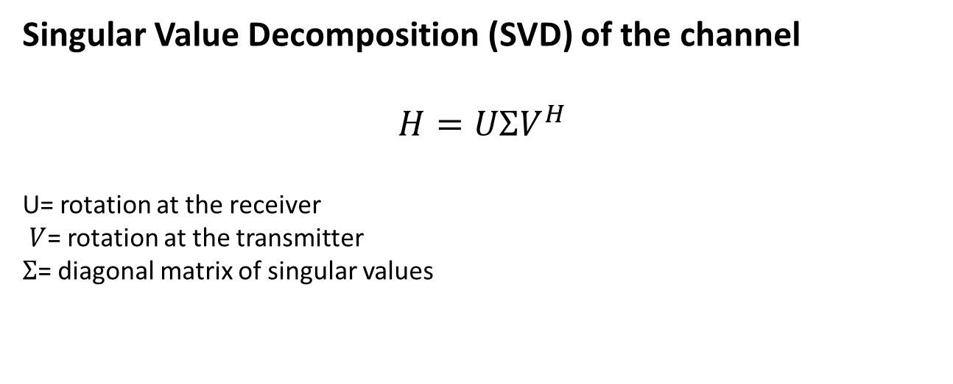
Why you can’t just “add more antennas” forever:
rank(H)
rank(H) ≤ min(Nt​,Nr​)
Number of parallel data streams ≤rank(H)
Singular Value Decomposition (SVD) of the channel
$$H=UΣV^{H}$$
U= rotation at the receiver
$V$= rotation at the transmitter
$Σ$= diagonal matrix of singular values
$$Σ=\left[\begin{matrix}σ_{1} & 0 & 0 \\ 0 & σ_{2} & 0 \\ 0 & 0 & σ_{3}\end{matrix}\right]$$

Slide 14
rank(H)
Rank is a measure of how many distinct spatial paths exist between Tx and Rx.
Rank is high when:
antennas are well spaced,
rich multipath,
different angles of arrival.
Rank is low when:
antennas too close,
line-of-sight only,
strong correlation,
not enough scattering.

Slide 15
MIMO Modes
Spatial multiplexing Mode
Diversity Mode
Beamforming/ Array Angle Mode

Slide 16
Diversity Techniques
Receive diversity
Selection Combining (SC)
Equal Gain Combining (EGC)
Maximum Ratio Combining (MRC)
Transmit diversity
STBC

Slide 17
Detection Techniques in MIMO Receivers
Linear Detection
Zero-Forcing (ZF)
MMSE
Non-linear Detection
SIC
V-BLAST
Sphere decoding

Slide 18
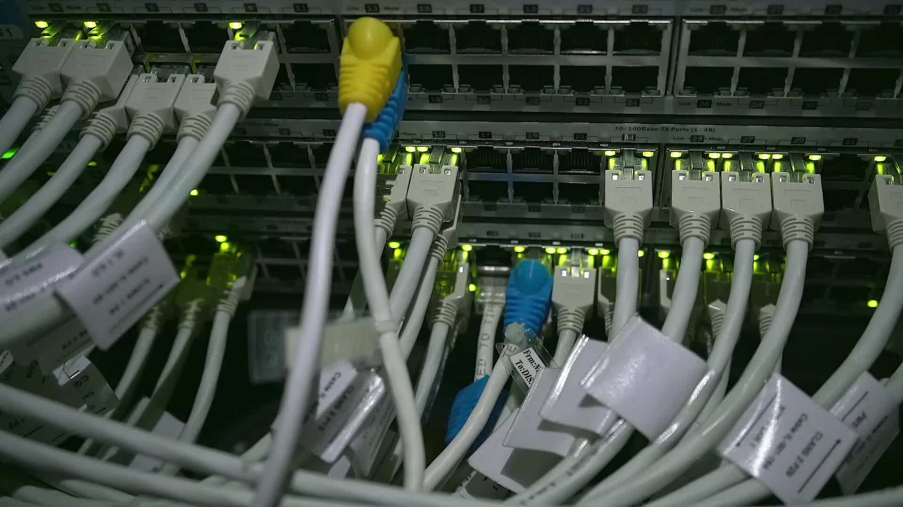
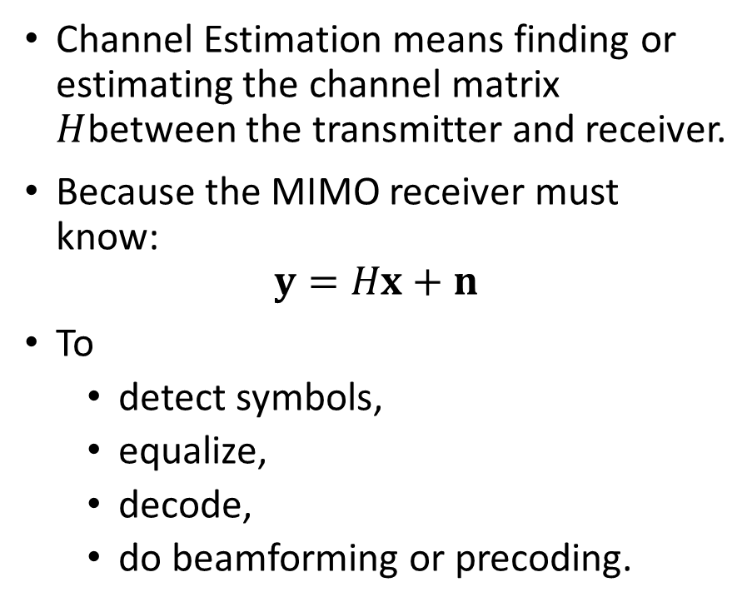
Channel Estimation in MIMO
Channel Estimation means finding or estimating the channel matrix $H$between the transmitter and receiver.
Because the MIMO receiver must know:
$$y=Hx+n$$
To
detect symbols,
equalize,
decode,
do beamforming or precoding.

Slide 19
Why CSI?
Without channel estimation, MIMO does not work.
MIMO receivers need the channel matrix to:
separate spatial streams,
cancel interference,
measure fading,
select MIMO mode.
Perfect CSI vs Imperfect CSI
At the transmitter → enables precoding and beamforming.
At the receiver → enables equalization, decoding.
Pilot-based Channel Estimation
Pilot contamination (massive MIMO challenge)
Estimation error propagation

Slide 20
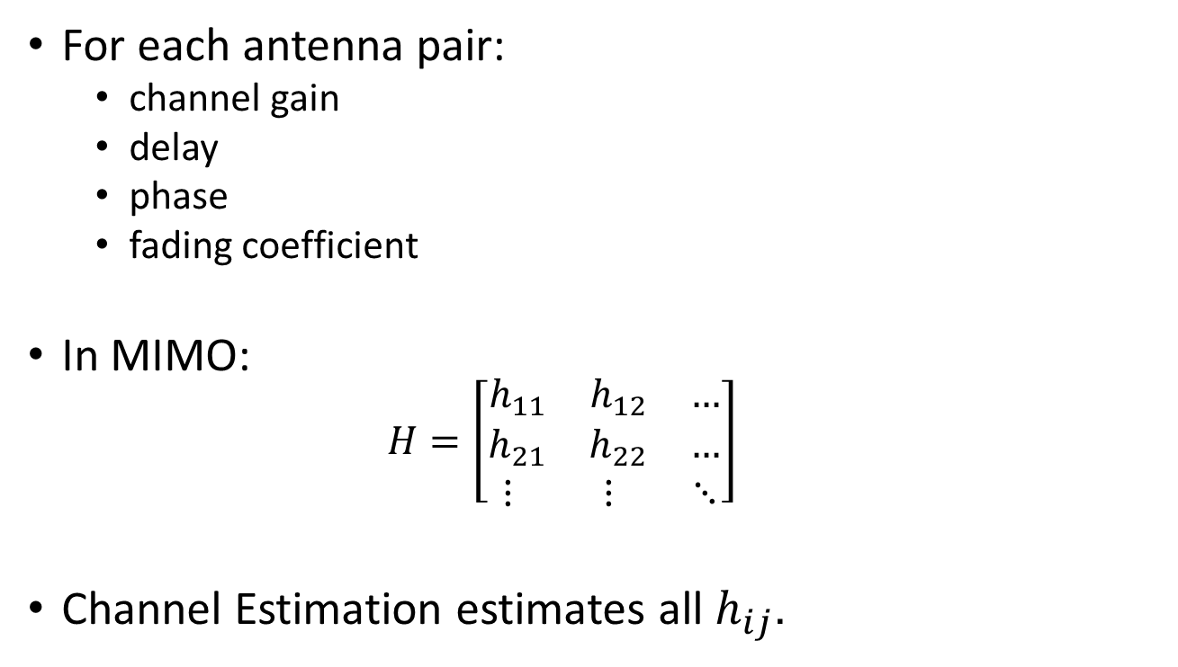
What information is estimated?
For each antenna pair:
channel gain
delay
phase
fading coefficient
In MIMO:
$$H=\left[\begin{matrix}h_{11} & h_{12} & … \\ h_{21} & h_{22} & … \\ ⋮ & ⋮ & ⋱\end{matrix}\right]$$
Channel Estimation estimates all $h_{ij}$.
Why Channel Estimation is harder in MIMO?

Slide 21
Types of Channel Estimation
Training-based Estimation
Transmitter sends known pilot symbols:
Receiver compares received pilots with known values.
Very common in 4G/5G/WiFi.
Blind Estimation
Uses only received data and statistical properties:
No pilots needed,
Low overhead,
Less accurate.
Semi-Blind
Combination of pilots + statistics:
Intermediate complexity/accuracy.

Slide 22
Channel Estimation in MIMO
Training-Based Methods:
Least Squares (LS),
Minimum Mean Square Error (MMSE)
Maximum Likelihood (ML).
Singular Value Decomposition (SVD):
Time-Frequency Methods:
Discrete Fourier Transform (DFT)
Discrete Wavelet Transform (DWT)
Compressed Sensing:
Basis Pursuit (BP)
Orthogonal Matching Pursuit (OMP).
Blind Estimation:
These methods include spatial covariance-based approaches, Independent Component Analysis (ICA), higher-order statistics (HOS), and blind Maximum Likelihood (ML) estimation.
Notes:
These methods utilize known pilot symbols or reference signals to estimate the channel coefficients.
SVD-based methods exploit the properties of the MIMO channel and perform SVD on the received signal to estimate the channel matrix.
Techniques such as Discrete Fourier Transform (DFT) or Discrete Wavelet Transform (DWT) can be used to estimate channel coefficients based on the characteristics of the channel in the time and frequency domains.
Compressed sensing techniques exploit the sparse nature of the MIMO channel to estimate the channel coefficients using methods like Basis Pursuit (BP) or Orthogonal Matching Pursuit (OMP).
Blind estimation techniques aim to estimate the channel characteristics without relying on known pilot symbols. These methods include spatial covariance-based approaches, Independent Component Analysis (ICA), higher-order statistics (HOS), and blind Maximum Likelihood (ML) estimation.

Slide 23
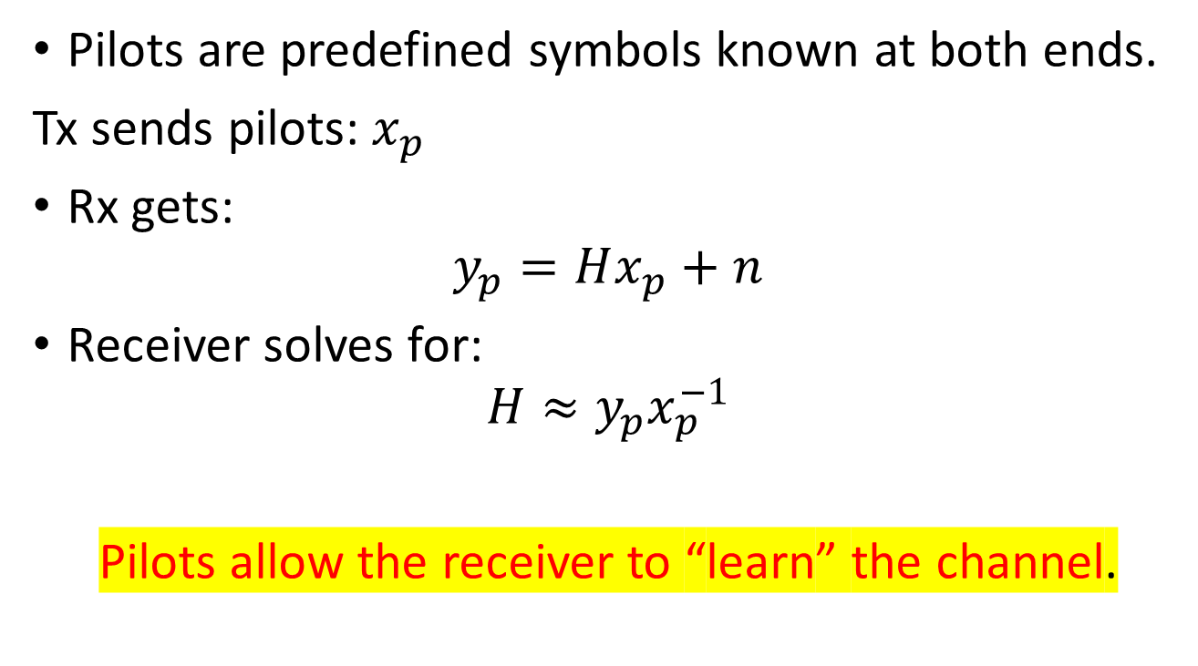
Pilot-based Channel Estimation (Most important)
Pilots are predefined symbols known at both ends.
Tx sends pilots:$x_{p}$
Rx gets:
$$y_{p}=Hx_{p}+n$$
Receiver solves for:
$$H≈y_{p}x_{p}^{−1}$$
Pilots allow the receiver to “learn” the channel.
Used in: LTE, 5G NR, WiFi (802.11n/ac/ax)

Slide 24
Challenges: Channel estimation in MIMO
Complexity:
Pilot Overhead:
Channel Correlation:
Interference and Noise:

Slide 25
Practical Issues in MIMO
Channel estimation
Feedback and CSI
Antenna correlation
Propagation environments

Slide 26
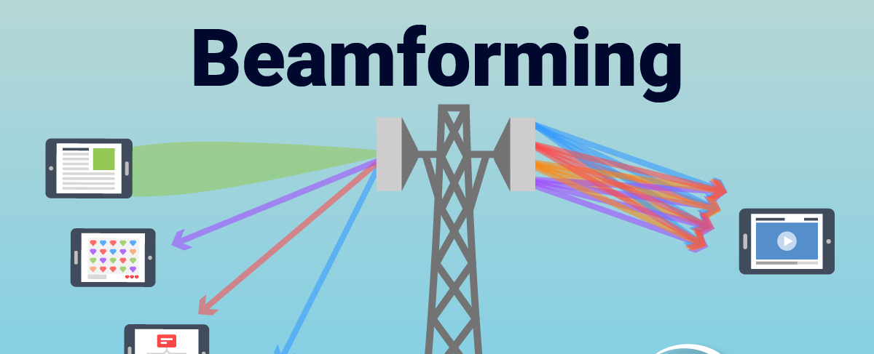
Beamforming is a multi-antenna technique that directs the transmitted or received signal in a particular spatial direction.
Instead of transmitting energy everywhere, we shape the antenna radiation pattern to boost signal towards intended user.

Slide 27

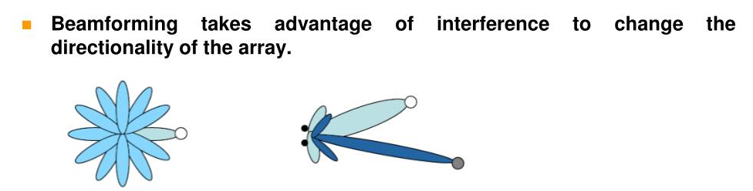
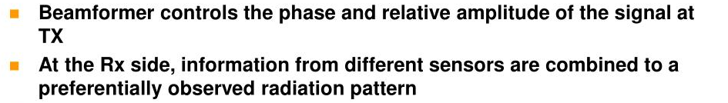
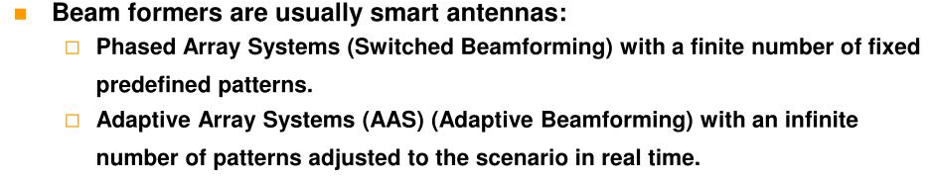

Slide 28

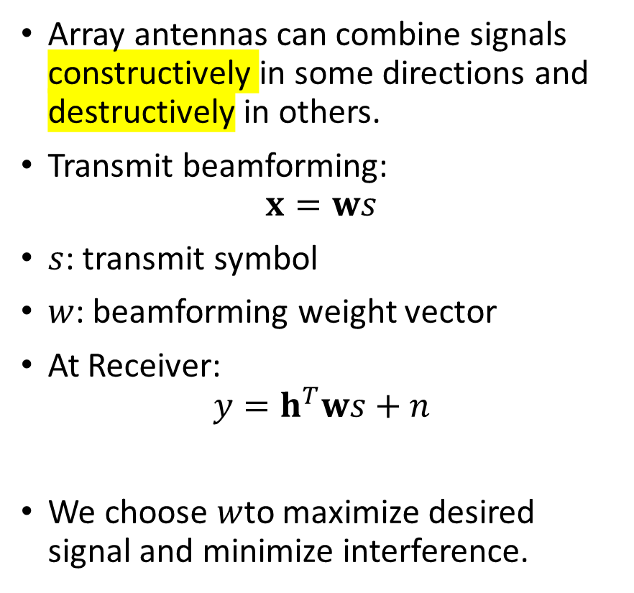
Basic Idea
Array antennas can combine signals constructively in some directions and destructively in others.
Transmit beamforming:
$$x=ws$$
$s$: transmit symbol
$w$: beamforming weight vector
At Receiver:
$$y=h^{T}ws+n$$
We choose $w$to maximize desired signal and minimize interference.

Slide 29
Why Beamforming?
✔ increase SNR ✔ improve coverage ✔ suppress interference ✔ spatial multiplexing ✔ used in LTE/5G, WiFi, satellite links

Slide 30
Types of Beamforming
1. Fixed Beamforming
Pre-defined beams
Used in early systems
2. Adaptive Beamforming
Weights automatically change according to channel.
3. Digital Beamforming
Separate DAC/ADC chains for each antenna.
4. Analog Beamforming
Uses phase shifters (useful in mmWave).
5. Hybrid Beamforming
Combination of digital + analog
Used in 5G to reduce RF chains.

Slide 31

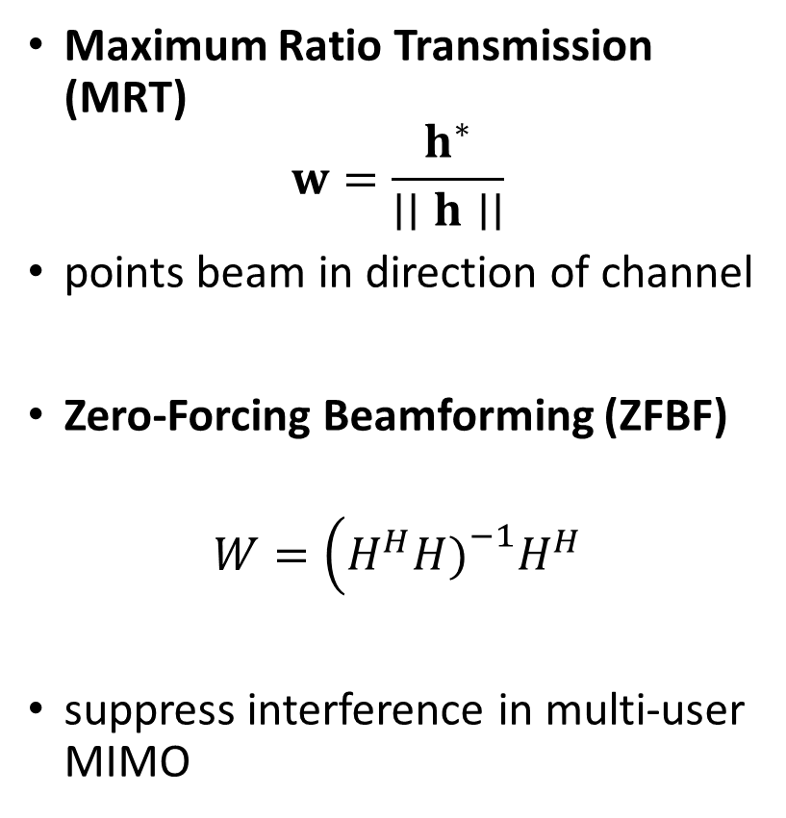
How is the Beamforming Vector Selected?
Maximum Ratio Transmission (MRT)
$$w=\frac{h^{∗}}{∣∣h∣∣}$$
points beam in direction of channel
Zero-Forcing Beamforming (ZFBF)
$$W=\left(H^{H}H{\left.)\right.}^{−1}H^{H}\right.$$
suppress interference in multi-user MIMO

Slide 32
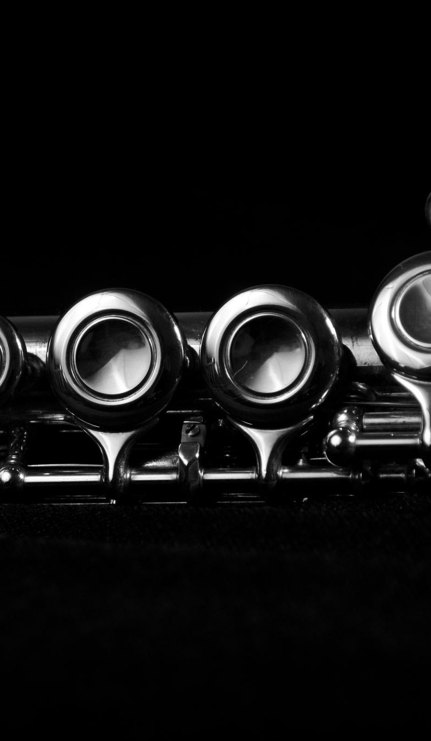

Beamforming at Receiver
Maximum Ratio Combining:
$$w_{i}=\frac{h_{i}^{∗}}{σ^{2}}$$
Benefits:
diversity gain,
suppress fading.

Slide 33
Challenges in Beamforming
Channel Estimation Accuracy:
Feedback Overhead:
Complexity and Implementation Constraints:
Multiuser Interference:
Notes:
Accurate channel estimation is essential for effective beamforming. Errors or inaccuracies in channel estimation can degrade the performance of beamforming algorithms and result in reduced signal quality or increased interference.
In certain MIMO systems, such as those with multiple transmit antennas, channel state information (CSI) feedback from the receiver to the transmitter is required for beamforming. This feedback incurs additional overhead in terms of bandwidth and latency.
Beamforming algorithms can be computationally complex, particularly for systems with a large number of antennas or high-dimensional channel matrices. Real-time implementation and hardware constraints must be considered.
Beamforming in multiuser MIMO systems requires careful coordination to avoid or minimize interference among different users. Techniques such as interference alignment or multiuser beamforming can be employed to address this challenge.

Slide 34
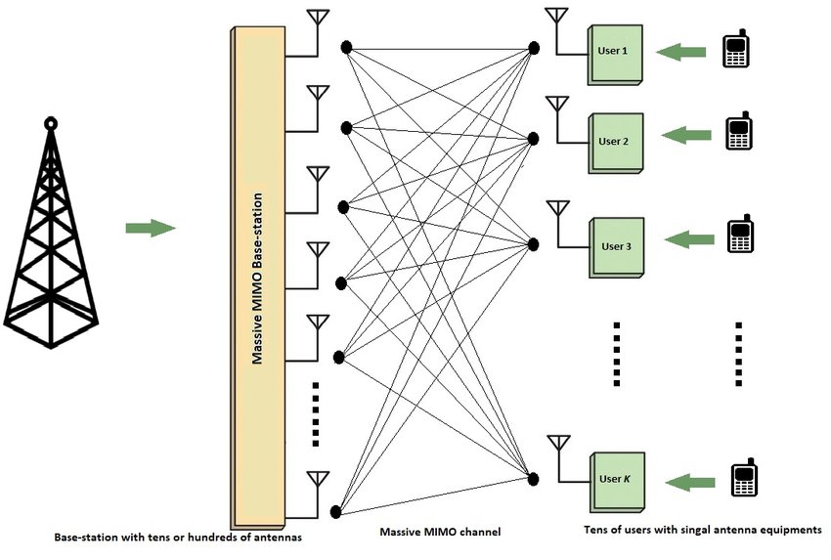
Massive MIMO
Massive MIMO = MIMO with very large number of antennas (dozens or hundreds).
Base station has many antennas, serving many users simultaneously on same time and frequency.

Slide 35
Why Massive MIMO?
✔ huge capacity increase ✔ spatial multiplexing for many users ✔ high SNR beams → better coverage ✔ energy efficient ✔ robustness to fading

Slide 36
Challenges in Massive MIMO
High channel estimation overhead
Hardware complexity
Antenna correlation
Pilot contamination
Hybrid beamforming design

Slide 37
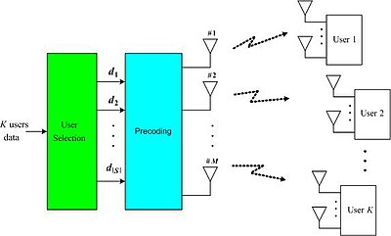
Multi-User MIMO
Massive MIMO stands for Massive Multiple-Input, Multiple-Output. It is an advanced wireless communication technology that utilizes a large number of antennas at the base station to enhance network capacity and spectral efficiency.​

Slide 38
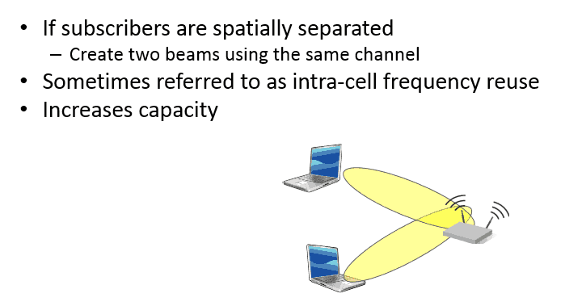
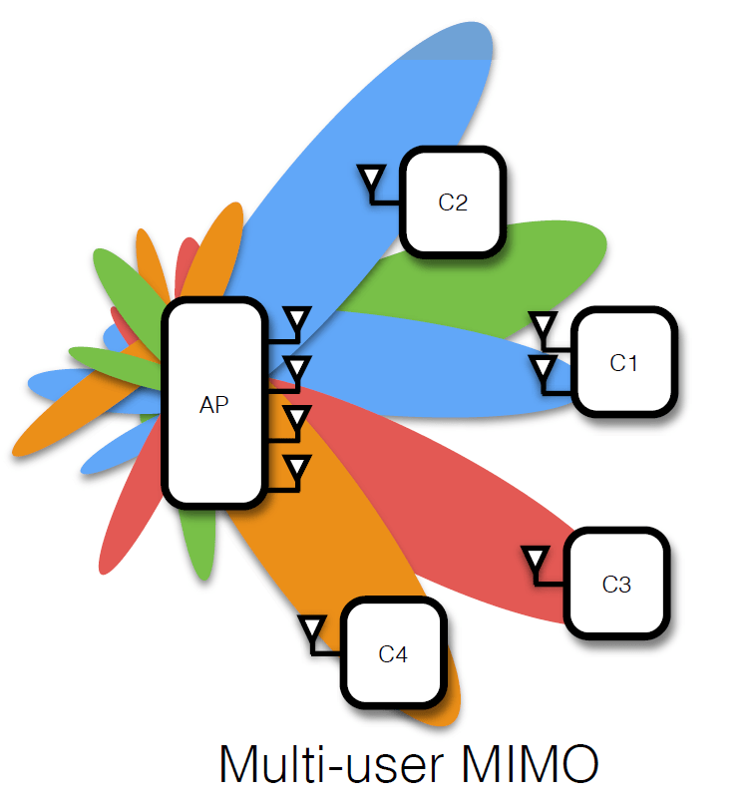
Multi-User MIMO

Slide 39
Multi-User MIMO-Highlights
Simultaneous Transmission:
Improved Spectral Efficiency:
Interference Mitigation:
User Fairness:
Device Flexibility:
Notes:
MU-MIMO enables the base station to transmit data to multiple users concurrently by utilizing multiple antennas. It allows for the simultaneous transmission of different data streams to different users on the same frequency and time resources.
By serving multiple users simultaneously, MU-MIMO improves spectral efficiency. It maximizes the utilization of available frequency bands, increasing the overall capacity of the wireless network.
MU-MIMO uses advanced signal processing techniques and beamforming to mitigate interference among users. By steering beams towards intended users and suppressing interference from other users, MU-MIMO enhances signal quality and network performance.
MU-MIMO algorithms aim to achieve fairness among users by dynamically allocating resources based on user requirements and channel conditions. This ensures that all users receive a fair share of network resources and maintain a certain level of quality of service.
MU-MIMO can adapt to varying device capabilities. It can serve users with different numbers of antennas, allowing devices with fewer antennas to benefit from improved signal quality and reduced interference even if they cannot fully exploit the spatial multiplexing benefits of MU-MIMO.

Slide 40
Real-World MIMO Implementation
LTE (explain MIMO modes)
Wi-Fi
Wireless backhaul
5G massive MIMO

Slide 41

Questions

